Slide 1
Accident Detection
TEAM MEMBERS:
Jhansi Somireddy (16338125)
Navya Gopalam (16338413)
Jyothirmai Bavirisetty (14422648)
Bhargavi Pasupuleti (18247614)

Slide 2
Overview Introduction Observations Analysis Techniques Models Results Challenges Future work

Slide 3
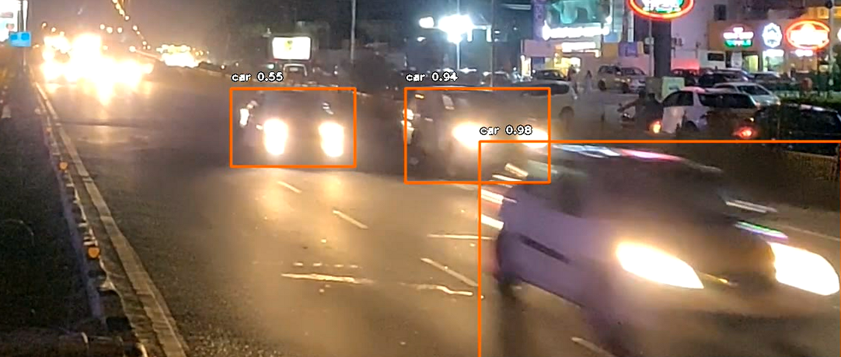
Introduction This project is trained with images where vehicles collided, and accident occurred and in test video if anything such collision happens between vehicles then application detect as accident. Training is done with TensorFlow and CNN Algorithm.

Slide 4
Observations/Techniques/Analysis Programming Language – Python Libraries: Pandas – To read the data from the database NumPy – For the mathematical calculations cv2- To read the image Willow- To process the images TensorFlow keras – To create the model Play sound library - Easy and simple way to play sound files in python

Slide 5
Model 1. We used CNN (Convolutional Neural Network) Model. The CNN is not a model itself. It is an algorithm, and it consists of many models. 2. We used sequential model from the CNN Algorithm for our project

Slide 6
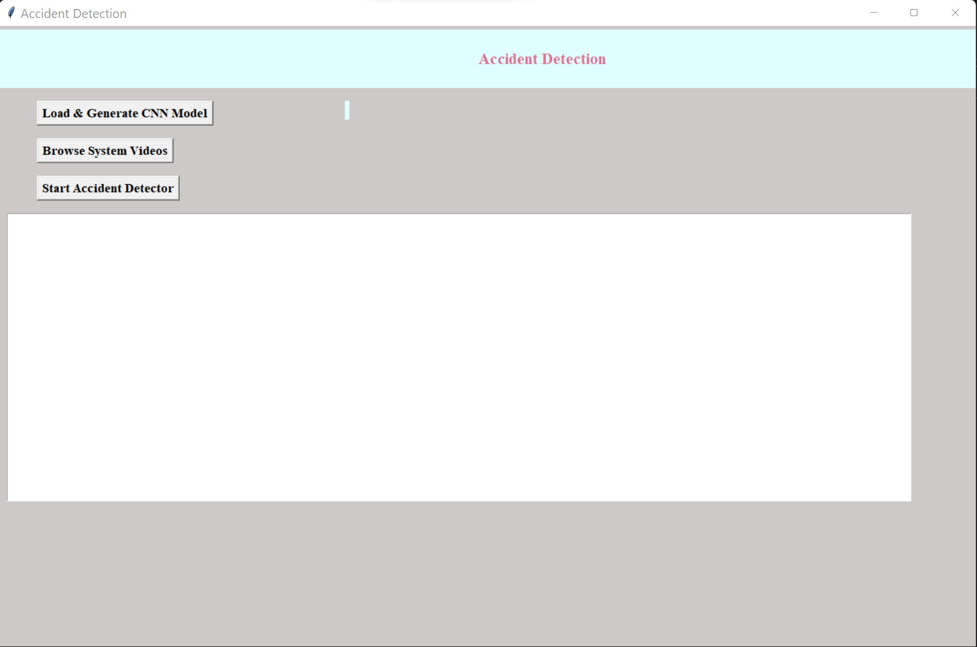
Results
To run the project double click on run.bat file to get below screen.
In Below screen click on ‘Load & Generate CNN Model’ button to trained CNN with dataset and to load CNN model using TensorFlow.

Slide 7
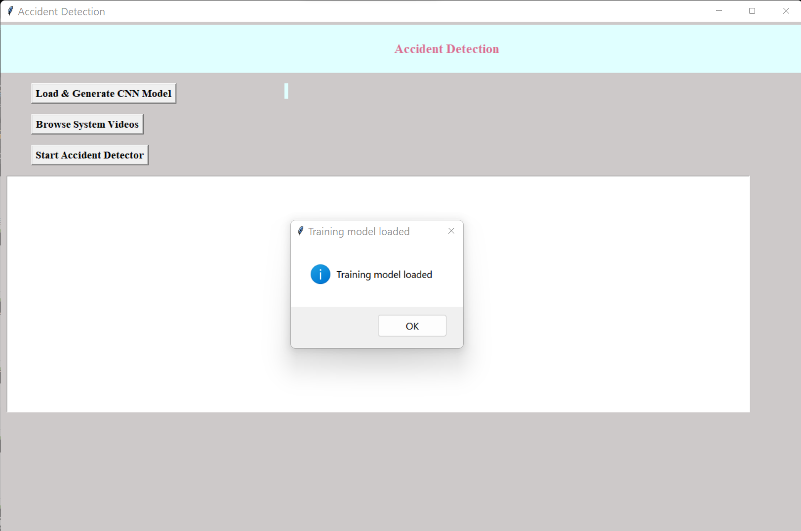
In Below screen TensorFlow model is loaded and now click on ‘Browse System Video’ button to upload video

Slide 8
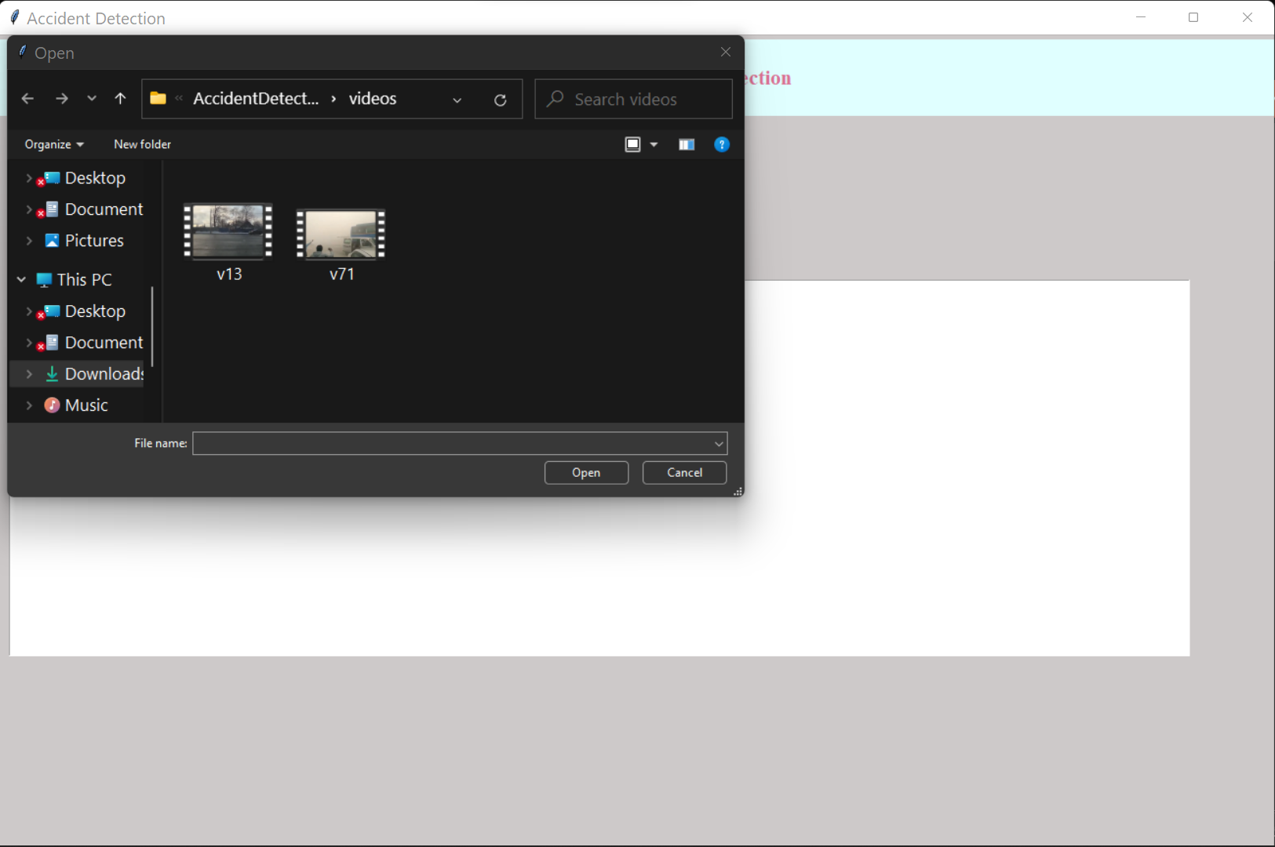
In Below screen selecting and uploading video and then click on ‘Open’ button to load video.

Slide 9
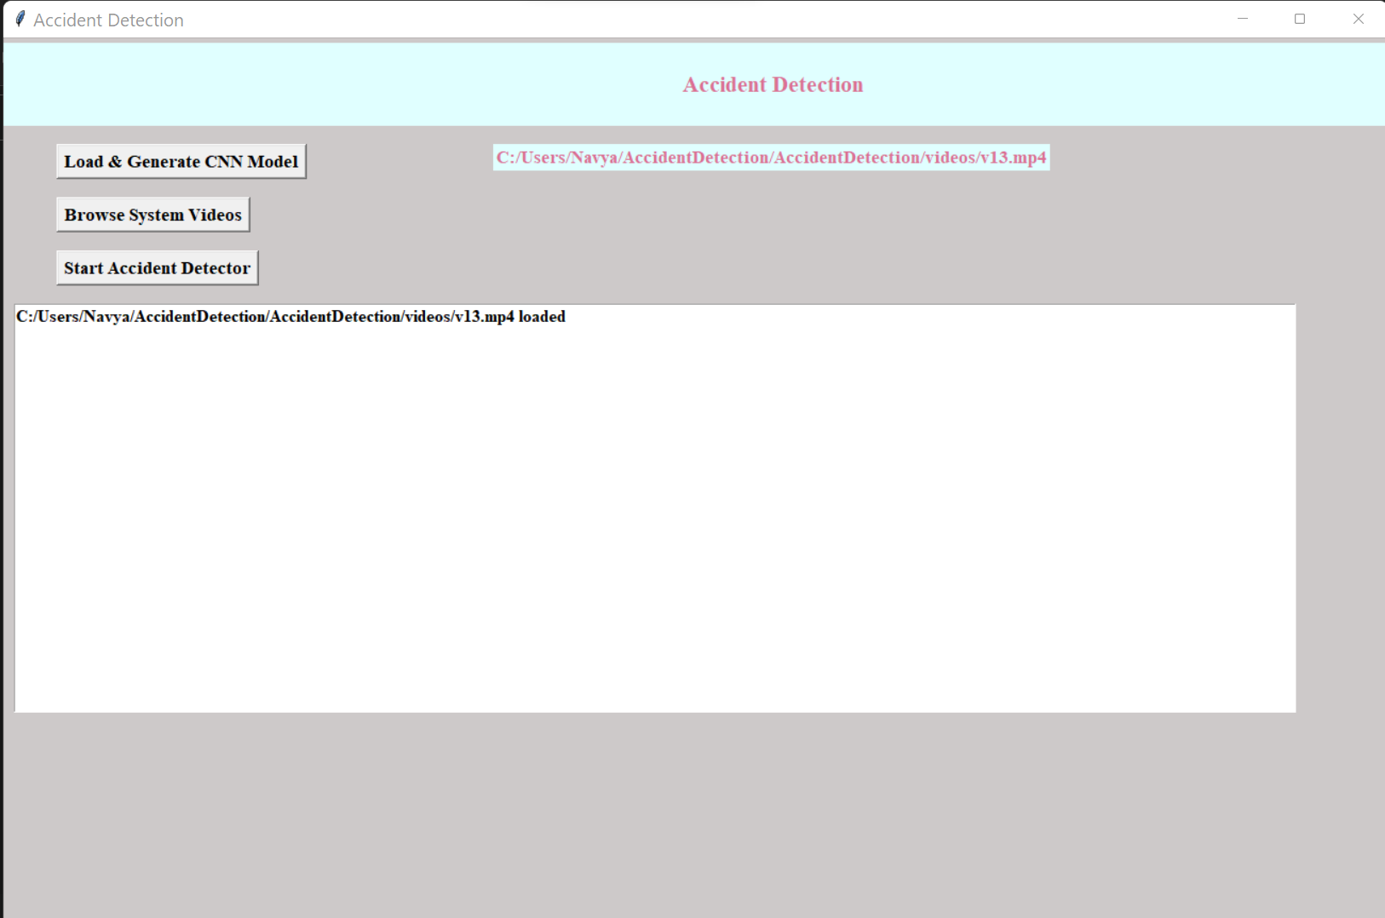
In Below screen video is loaded and now click on ‘Start Accident Detector’ button to play video and detect accident.

Slide 10
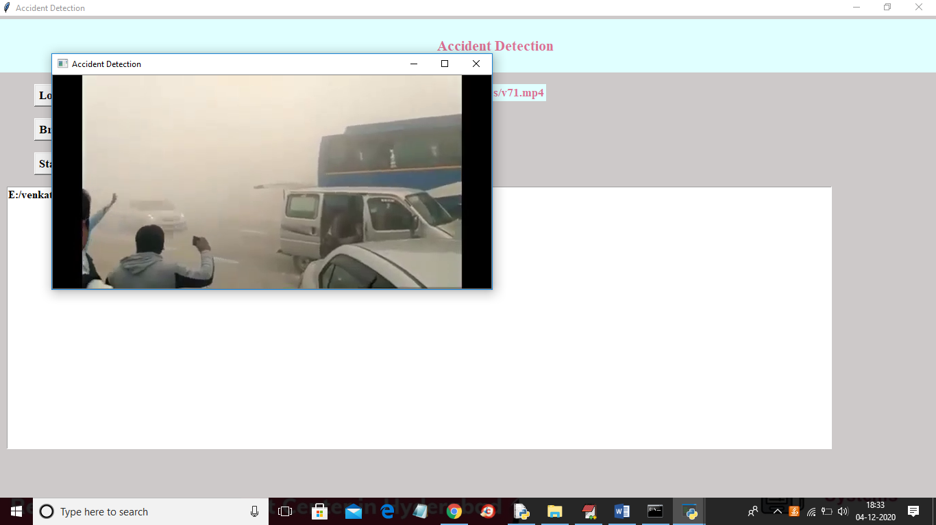
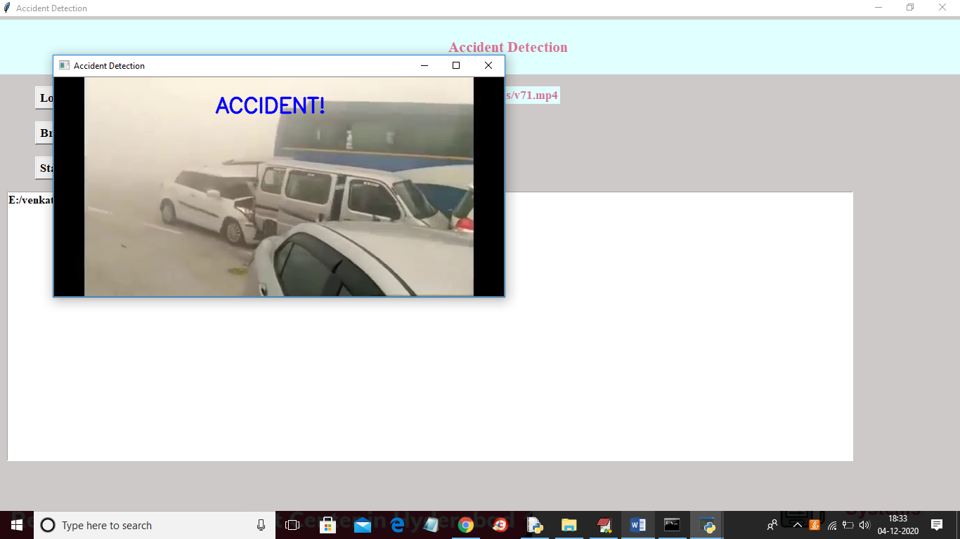
In Below screen video start playing and upon accident detection will get below screen with beep sound.

Slide 11
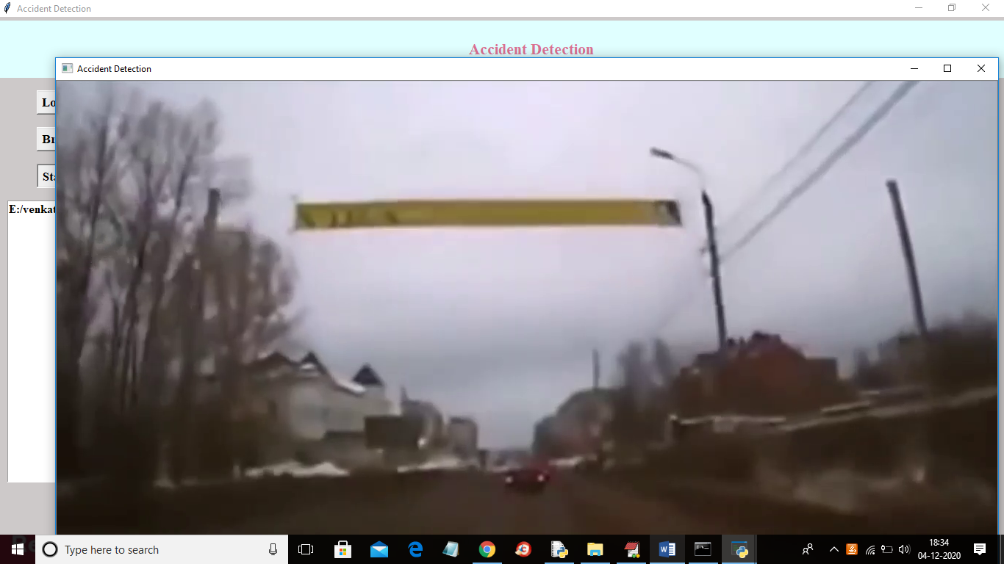
In below screen playing another video without message if normal driving appear

Slide 12
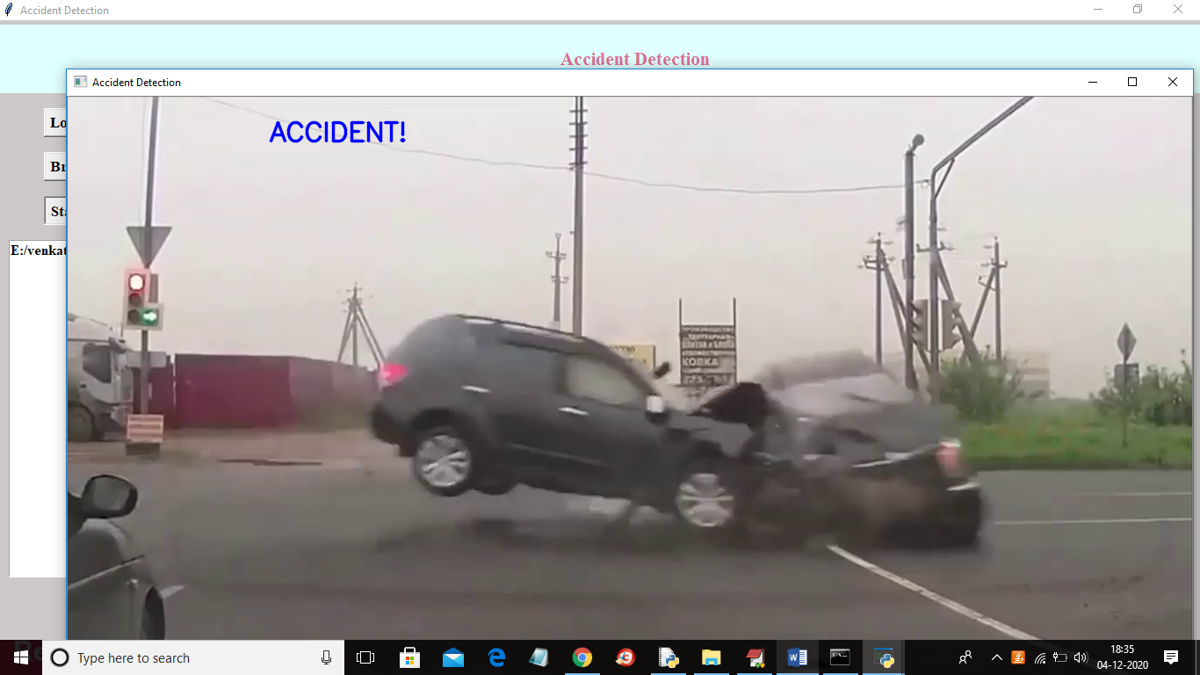
In Below screen upon collision then accident display message will appear with beep sound

Slide 13
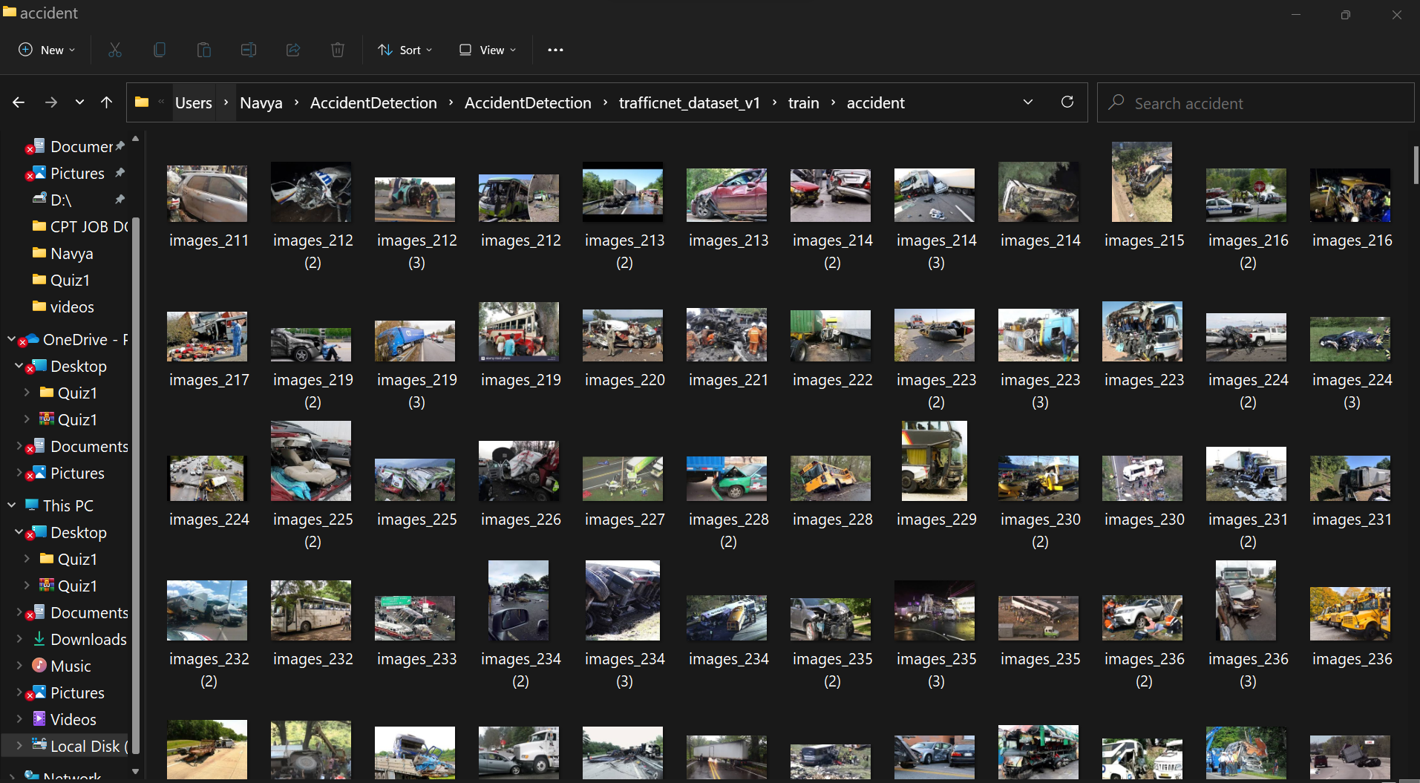
In below screen application is trained with below images

Slide 14
Challenges 1. Our Model Works only if two vehicles crashed into each other. 2. It can not detect any self-made accidents like falling off the road, flying and crashing on the road without the interference of any other vehicle.

Slide 15
Future work 1. We will work on our model to detect self made accidents also. 2. We will train our model to differentiate between collision and accidents that are happened without crashing into another vehicle.

Slide 16
THANK YOU

